Slide 1
File Handling

Slide 2
Overview
We can mix C++ with .txt file!
We can read, write (by replacing the old file), or write on the existing file, we can do so in command prompt as well!

Slide 3
First step
We need to include
#include <fstream> in the header, in order to handle file input or output
For input:
We need to have :
ifstream <variable name> to hand input. (Notice a lot of times we would name that variable name as fin, to remember that it’s very close to the functionality of cin
ofstream <variable name> to hand output. (Notice a lot of times we would name that variable name as fout, to remember that it’s very close to the functionality of cout
Example next slide

Slide 4
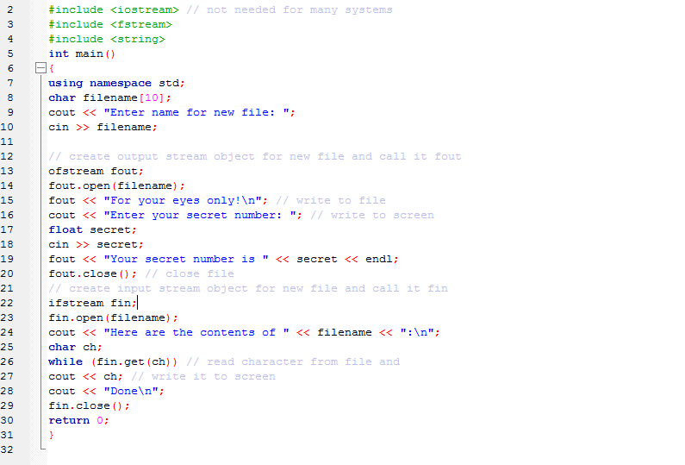

Slide 5
A few reminder
Notice that for filename, fstream only works with string as array. To use string class, you have to include .c_str() at the end

Slide 6
File mode
We have different mode to handle various request. For example, we can decide to write content at the end of the file (append). The mode for append is ios_base::out | ios_base::trunc);
A complete list for the file mode is on next page:

Slide 7
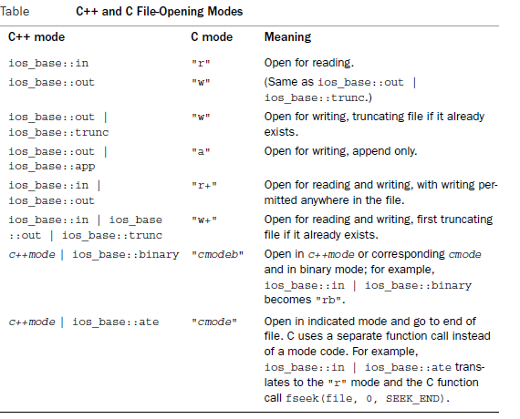
File mode

Slide 8
A few reminders of the next example:
1. cin.fail()→check if it’s the end of file
2. Try to close the file whenever you finish (eg. fin.close() and fout.close())
3. Look at the file mode
4. c.str()
5. download the program and try it out!!

Slide 9
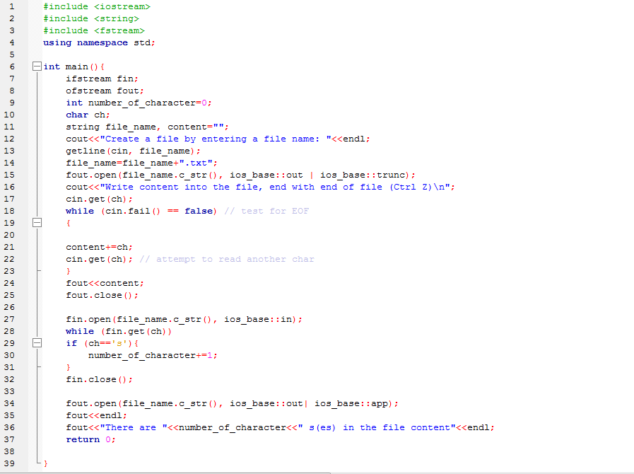

Slide 10
File Handling next step
We could mix file handling with command prompt and directory
../→the directory above (before)
../../→two directories above (before)
./→directory below (after)
In case of entering invalid directory, we need .is_open() to check if we can open the file (fin.is_open() or fout.is_open())
We also have the specific method for handling error (cerr and exit()→exit() needs #include <cstdlib>)
Pay attention to the next 3 examples for the important points mentioned above

Slide 11
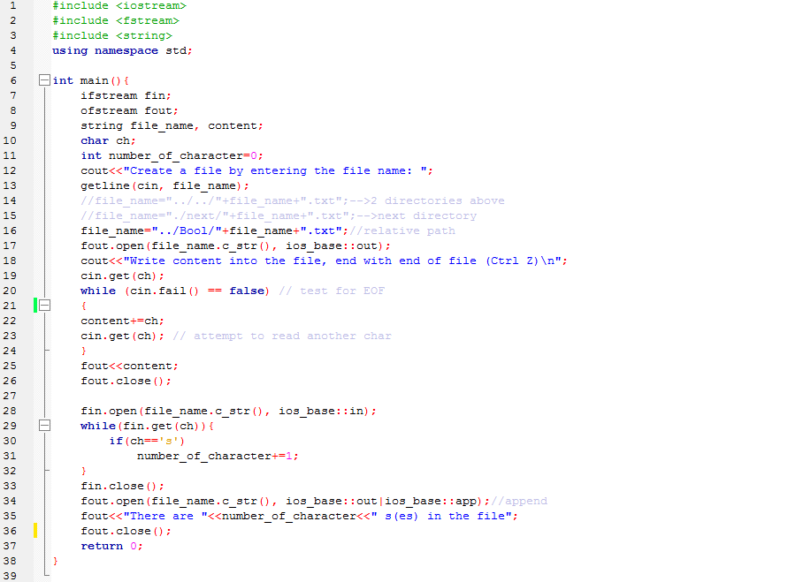

Slide 12
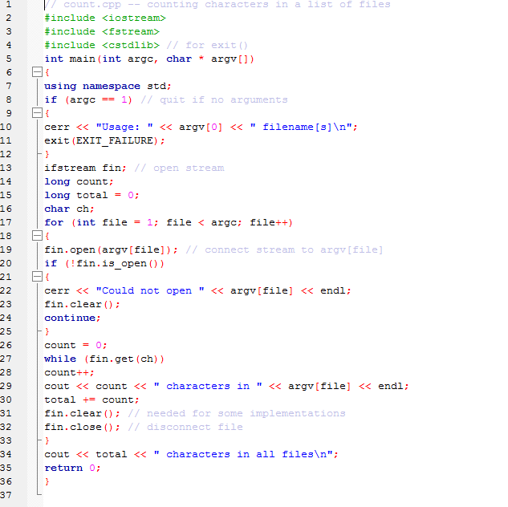

Slide 13
